Slide 1


Module 7 Unit 10
Research Proposal

Slide 2


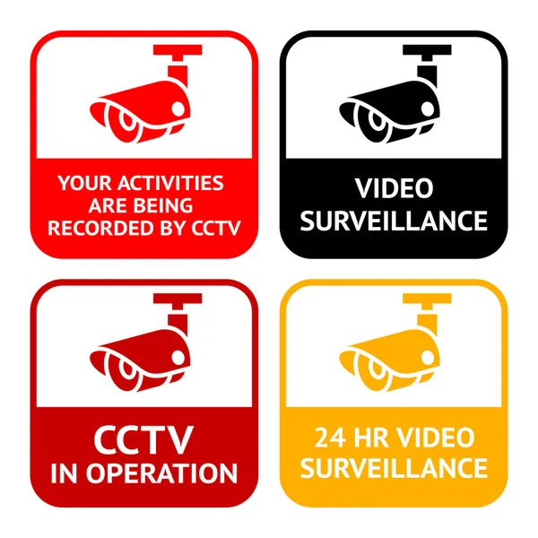


Title of research
Utilising and adapting IoT technology in secondary education
- The use of IoT devices in secondary schools
- Students and teachers are using IoT for many aspects
Research the benefits and impacts of IoT utilisation in secondary schools.

Slide 3





Significance of the research
IoT is widely used in secondary education
IoT can help teachers reduce workload
Students needs can be tracked easily. E.g. SEN
Impacts of using the IoT: privacies, personal data exposure and non-compliant with regulations and laws. E.g. GPDR, DSS, HIPPA

Slide 4

Research question
IoT is widely used in secondary education, do the students and teachers understand how to use it correctly?
While they enjoy the benefits of IoT devices and technologies, do they know and minimise the impact, such as privacy and personal data security.

Slide 5

Aims and Objectives
To identify the most popular IoT devices or technologies utilised in secondary institutions.
To identify the benefits of utilising IoT in secondary schools
To identify the impact of IoT utilisation
A short survey:
1. Do they use IoT in school. For example, smartphones, tablets, computers, smartcards, etc. 2. Which kind of IoT do they use the most 3. Do they need to log in when accessing their IoT devices or websites 4. Will they share the IoT devices with others 5. Will the IoT for their personal use. For example, access their personal social media and email accounts. 6.How long will they change their password 7. Will they reuse their previous passwords 8. Will they use the same password in both personal and school accounts 9. Will they store the school accounts passwords into their personal computers 10. Will they share the password with others. 11. Will they lock or shutdown their laptop/tablet after use. 12. Any regulation or compliance policy they need to follow when accessing a student’s information (For staff only). 13. Do they think they have followed the compliance policy strictly (For staff only). 14. Do they have their own login when accessing any student information (For staff only). 15. How do they store the data, any encryption (For staff only) (Senthilkumar, Kavitha & V E., 2017).

Slide 6

Literature related to the project:
1. Canbaz, A., OHearon, K., McKee, M. and Hossain, M. (2022). IoT Privacy and Security in Teaching Institutions: Inside The Classroom and Beyond. 2021 ASEE Annual Conference, [online] (33905), p.2-4. Available at: https://strategy.asee.org/iot-privacy-and-security-inteaching-institutions-inside-the-classroom-and-beyond.pdf
2. Alexei, Arina & Alexei, Anatolie. (2021). Analysis of IoT security issues used in Higher Education Institutions. International Journal of Mathematics and Computer Applications Research. 9. 2277-2286. 10.47191/ijmcr/v9i5.01.
3. A. Jaklié, "Educating the Educators for Introducing Internet of Things to Primary and Secondary Schools’ Curriculums," 2020 43rd International Convention on Information, Communication and Electronic Technology (MIPRO), 2020, pp. 632-635, doi: 10.23919/MIPRO48935.2020.9245223.
4. Francisti, J., Balogh, Z., Reichel, J., Magdin, M., Koprda, Š. and Molnár, G., 2020. Application Experiences Using IoT Devices in Education. Applied Sciences, [online] 10(20), p.7286. https://doi.org/10.3390/app10207286.
5. Mishra, Aryan & Karthikeyan, J. & Barman, Binoy & Veettil, Roy. (2020). Journal of Critical Reviews REVIEW ON IOT IN ENHANCING EFFICIENCY AMONG HIGHER EDUCATION INSTITUTIONS. 10.31838/jcr.07.01.109.
6. BAGHERI, Maryam and HAGHIGHI MOVAHED, Siavosh (2017). The Effect of the Internet of Things (IoT) on Education Business Model. In: 2016 12th International Conference on SignalImage Technology & Internet-Based Systems (SITIS). IEEE Computer Society, 435-441.
7. Sha, K., Wei, W., Andrew Yang, T., Wang, Z. and Shi, W. (2018). On security challenges and open issues in Internet of Things. Future Generation Computer Systems, 83, pp.326–337.
8. Park, M., Oh, H., & Lee, K. (2019). Security Risk Measurement for Information Leakage in IoTBased Smart Homes from a Situational Awareness Perspective. Sensors (Basel, Switzerland), 19(9), 2148. https://doi.org/10.3390/s19092148
9. Tomás, Cecília & Teixeira, Antonio. (2020). Ethical Challenges in the Use of Iot in Education: On the Path to Personalization. EDEN Conference Proceedings. 217-226. 10.38069/edenconf-2020-rw-0024.
10. Garg, R. (2018). Open data privacy and security policy issues and its influence on embracing the Internet of Things. First Monday, 22(5).
11. Office of the Victorian Information Commissioner. (2021.). Internet of Things and Privacy -Issues and Challenges. [online] Available at: https://ovic.vic.gov.au/privacy/internet-ofthings-and-privacy-issues-and-challenges/
12. Data protection: a toolkit for schools Open Beta: Version 1.0. (2018). [online] Available at: https://assets.publishing.service.gov.uk/government/uploads/system/uploads/attachment_ data/file/747620/Data_Protection_Toolkit_for_Schools_OpenBeta.pdf

Slide 7

Research Design
Case studies
Questionnaire

Slide 8



Ethical considerations and risk assessment
Questionnaire: A consent statement
“Do you agree to the above terms? By clicking Yes, you consent that you are willing to answer the questions in this survey.”
“Do you consent to your personal data being processed as described above? You must click Yes in order to take the survey.” (Surveymonkey, 2022)

Slide 9


Artefacts that will be created
Data from the questionnaires – answers and responses.
Questionnaire analysis. For example, the behaviour of using IoT, awareness of cyber security, etc. This will be part of the quantitative research: the numerical data will become statistics, to analyse and interpret the statistics and get a conclusion (Kirsty and Graeme, 2018).
The study's outcome: Levels of IoT utilisations in secondary education institutions and their impact of cybersecurity to the users.
Suggestions, if any. This will be qualitative research, which means I will collect non-numerical data, such as comments, opinions, and experiences, in this case, gather in-depth insight into the cyber security-related problem of using IoT, and recommend any solution on the research.

Slide 10
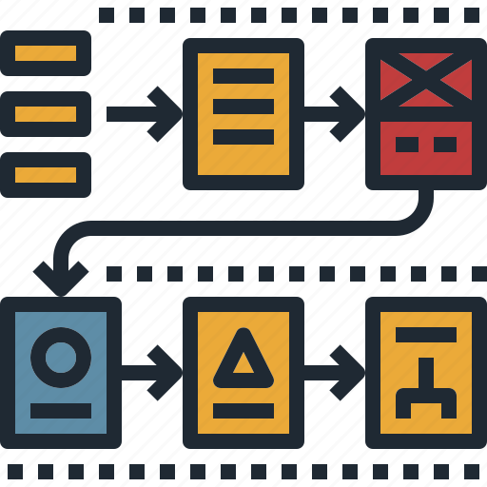
Timeline of proposed activities
Create and desgin questionnaire (1 week)
Check the questions of the questionnaire (1 week)
Publish the questionnaire, advertise to education agents, secondary students and staff to participate (2 weeks)
Collection of surveys (1 week)
Analysis of the data (1 week)
Start writing the research (2-12 weeks)

Slide 11

References
Help.surveymonkey.com. (2022). Adding a Consent Statement or Privacy Notice. [online] Available at: https://help.surveymonkey.com/articles/en_US/kb/How-do-I-create-a-consent-form-or-disqualify-respondents-from-a-survey.
Data protection: a toolkit for schools Open Beta: Version 1.0. (2018). [online] Available at: https://assets.publishing.service.gov.uk/government/uploads/system/uploads/attachment_data/file/747620/Data_Protection_Toolkit_for_Schools_OpenBeta.pdf.
Senthilkumar, Kavitha & V E., Sathishkumar. (2017). A Survey on Cyber Security awareness among college students in Tamil Nadu. IOP Conference Series: Materials Science and Engineering. 263. 042043. 10.1088/1757-899X/263/4/042043.
Kirsty Williamson and Graeme Johanson (2018). Research methods : information, systems, and contexts. Cambridge, Ma Chandos Publishing.
Bhandari, P. (2020). An introduction to qualitative research. [online] Scribbr. Available at: https://www.scribbr.com/methodology/qualitative-research/.

